Slide 1


8 paskaita. Triukai su sąrašais
1 LYGIS
2023
Aurimas Aleksandras Nausėdas
Notes:
Sveiki, siandien as kalbesiu angliskai kaip supratau kai jus prasete manes pirmadieni. Komentarai skaidres bu anglsiki po pirmu diveju skaidiru lietuviskai. Taigi ()

Slide 2
8 paskaita. Triukai su sąrašais
Šiandien išmoksite
01
Funkcijas map, filter, reduce, mean, median, sum, max, min
02
Sąrašo apimtis (List Comprehension)
03
Duomenų rūšiavimo būdus
Notes:
Pakalbekime siandien apie map, filter, reduce, mean, median, sum, max ir min python funkcijas bei ka jus siek tiek jau matete tai list comprehensions (saraso apimtis) ir baigsime duomenu ruosiavimo budais. Beje pavyzdziai bus lietuviski bet informacija bus pateikta angliskai su lietuviskais pavyzdziu paaiskinimais. () So let’s begin ()

Slide 3
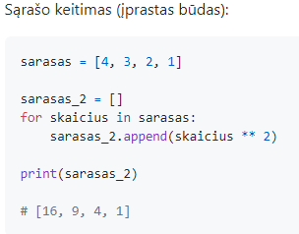
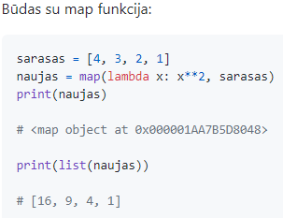
8 paskaita. Triukai su sąrašais
Funkcija map
1
Notes:
Today, we're going to explore the map function in Python. The map function is a powerful tool that allows us to apply a specific operation to each element in a given list, resulting in a new list with the transformed values. It provides a more concise and efficient alternative to traditional for loops for list transformation.
Let's start by looking at the conventional way of transforming a list. Suppose we have a list called sarasas with the values [4, 3, 2, 1], and we want to square each element and store the results in a new list called sarasas_2. We can achieve this using a for loop, like so:
sarasas = [4, 3, 2, 1] sarasas_2 = [] for skaicius in sarasas: sarasas_2.append(skaicius ** 2) print(sarasas_2) # Output: [16, 9, 4, 1]
In this example, we iterate over each element in the sarasas list, square it using the ** operator, and append the result to the sarasas_2 list. Finally, we print the sarasas_2 list, which contains the squared values.
While this approach works perfectly fine, it requires more code and can be less readable, especially when dealing with complex operations. This is where the map function comes in handy. Let's rewrite the above example using the map function:
sarasas = [4, 3, 2, 1] naujas = map(lambda x: x ** 2, sarasas) print(naujas) # Output: <map object at 0x000001AA7B5D8048> print(list(naujas)) # Output: [16, 9, 4, 1]
In this new approach, we start by calling the map function. The map function takes two arguments: the first argument is the function or lambda expression that defines the operation we want to apply, and the second argument is the list we want to transform (sarasas in this case).
In our example, we define a lambda function lambda x: x ** 2, which squares each element x. The map function applies this lambda function to each element of the sarasas list, creating a map object, which is a special iterator.
When we print naujas directly, we get <map object at 0x000001AA7B5D8048>. This is because naujas is an iterator object that hasn't been consumed yet. To see the transformed values, we need to convert the iterator into a list using the list function, as shown in the next line.
By calling list(naujas), we convert the naujas map object into a list, and the output is [16, 9, 4, 1], which is exactly what we expect.
To summarize, the map function is a powerful tool for transforming lists in Python. It takes a function or lambda expression and applies it to each element of the given list, returning a new map object. To obtain the transformed values, we need to convert the map object into a list using the list function.
The example provided demonstrates how to use the map function to square each element in a list. The conventional approach using a for loop is compared to the more concise and efficient approach using the map function.
Remember, the map function is just one of many useful functions Python provides for list manipulation. Exploring and understanding these functions will help you become a more proficient Python programmer.

Slide 4
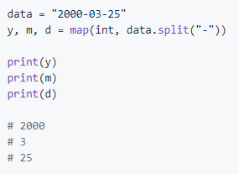
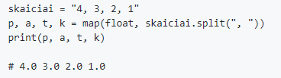
8 paskaita. Triukai su sąrašais
Datos išskirstymas su map
2
Notes:
Let's continue our exploration of data manipulations using the map function in Python. The map function is a powerful tool that allows us to transform and manipulate data efficiently. It's particularly useful when dealing with structured data or when we need to convert data types. Let's dive into some examples to further understand how the map function can be applied.
In our next example, we have a string called data with the value "2000-03-25". Our goal is to extract the year, month, and day from this string. We can achieve this using the map function along with some additional operations. Take a look at the code below:
data = "2000-03-25" y, m, d = map(int, data.split("-")) print(y) print(m) print(d)
In this code snippet, we start with the data string, which represents a date in the format "yyyy-mm-dd". We use the split method to split the string at each occurrence of the hyphen -, resulting in a list of three substrings: ["2000", "03", "25"].
Now, let's focus on the map function. We use the map function with the int function as the transformation function. The int function is responsible for converting each substring into an integer. We pass the data.split("-") expression as the second argument to the map function.
The map function applies the int function to each element of the list generated by data.split("-"). The result of the map function is then unpacked into three variables: y, m, and d, representing the year, month, and day, respectively.
When we print y, m, and d, we get the following output:
2000 3 25
By using the map function along with the int function, we successfully extracted the year, month, and day from the date string and converted them into integer values.
Now, let's move on to another example involving comma-separated values. Suppose we have a string called skaiciai with the value "4, 3, 2, 1". Our objective is to extract each number as a float value. Once again, the map function comes to the rescue. Take a look at the code below:
skaiciai = "4, 3, 2, 1" p, a, t, k = map(float, skaiciai.split(", ")) print(p, a, t, k)
In this code snippet, we have the string skaiciai, which represents a sequence of numbers separated by commas. We use the split method to split the string at each occurrence of the comma, resulting in a list of substrings: ["4", "3", "2", "1"].
Next, we use the map function once again, but this time with the float function as the transformation function. The float function is responsible for converting each substring into a floating-point number. We pass the skaiciai.split(", ") expression as the second argument to the map function.
The map function applies the float function to each element of the list generated by skaiciai.split(", "). The result of the map function is then unpacked into four variables: p, a, t, and k, representing the respective numbers.
When we print p, a, t, and k, we get the following output:
4.0 3.0 2.0 1.0
By utilizing the map function with the float function, we successfully extracted and converted each number from the comma-separated string into float values.
To summarize, the map function is a versatile tool for data manipulations in Python. It allows us to transform and manipulate data efficiently. The examples provided demonstrated how the map function can be used to extract date components and convert comma-separated values to different data types.
The first example showed how we can use the map function with the int function to extract the year, month, and day from a date string. The second example showcased how the map function, combined with the float function, can be used to extract and convert comma-separated values into float values.
By utilizing the map function, we can perform data manipulations more efficiently and write concise code. Keep exploring the capabilities of the map function as it will enhance your data manipulation skills in Python.

Slide 5
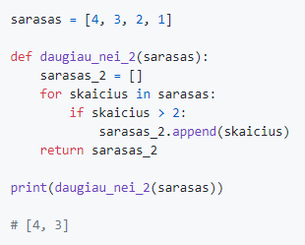
8 paskaita. Triukai su sąrašais
Sąrašo filtravimas (įprastas būdas)
3
Notes:
Now we're going to explore list filtering in Python. List filtering is a technique that allows us to selectively extract elements from a list based on specific conditions or criteria. It's a powerful tool that helps us work with only the elements that meet our requirements. Let's dive into an example to understand how list filtering works.
In the example provided, we have a list called sarasas with the values [4, 3, 2, 1]. Our goal is to filter out the elements that are greater than 2 and create a new list containing only those values. Let's take a look at the code:
sarasas = [4, 3, 2, 1] def daugiau_nei_2(sarasas): sarasas_2 = [] for skaicius in sarasas: if skaicius > 2: sarasas_2.append(skaicius) return sarasas_2 print(daugiau_nei_2(sarasas)) # Output: [4, 3]
In this code snippet, we define a function called daugiau_nei_2 that takes a list (sarasas) as input. Inside the function, we initialize an empty list called sarasas_2. We then use a for loop to iterate over each element in the sarasas list.
For each element, we check if it is greater than 2 using the if condition. If the condition is true, we append the element to the sarasas_2 list. Finally, we return the sarasas_2 list as the result of the function.
When we call the daugiau_nei_2 function with the sarasas list as an argument and print the result, we get the following output:
[4, 3]
By executing this code, we successfully filtered out the elements that are greater than 2 and created a new list (sarasas_2) containing only those values.
To summarize, list filtering is a technique in Python that allows us to selectively extract elements from a list based on specific conditions. It involves iterating over each element in the list, applying a condition using an if statement, and appending the desired elements to a new list.
In the provided example, we filtered out the elements greater than 2 from the sarasas list using a conventional approach with a for loop and an if condition. However, it's worth mentioning that Python provides more concise and efficient ways to achieve list filtering, such as using list comprehensions or built-in functions like filter().
List comprehensions provide a compact syntax for filtering elements in a list. The previous example could be rewritten using a list comprehension as follows:
sarasas = [4, 3, 2, 1] sarasas_2 = [skaicius for skaicius in sarasas if skaicius > 2] print(sarasas_2) # Output: [4, 3]
In this code snippet, we create a new list called sarasas_2 using a list comprehension. The list comprehension iterates over each element skaicius in the sarasas list and checks if it is greater than 2. If the condition is true, the element is included in the sarasas_2 list.
The result is the same as before: [4, 3]. List comprehensions provide a concise and readable way to achieve list filtering in Python.
In conclusion, list filtering is a fundamental technique in Python that allows us to extract elements from a list based on specific conditions. It provides us with the flexibility to work with only the elements that meet our requirements.
Whether you choose the conventional approach with a for loop and an if condition or utilize more concise methods like list comprehensions or built-in functions, list filtering is an essential skill for data manipulation in Python.

Slide 6
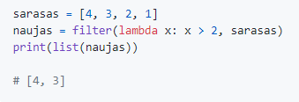
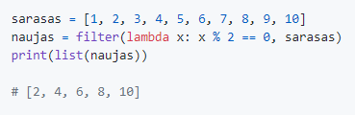
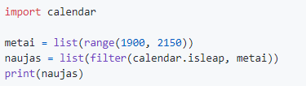
8 paskaita. Triukai su sąrašais
Funkcija filter
4
Notes:
Other thing we're going to explore the filter() function in Python. The filter() function is a powerful tool for selectively filtering elements from a sequence based on specific conditions. It allows us to create a new sequence containing only the elements that satisfy the specified condition. Let's dive into some examples to understand how the filter() function can be applied.
In our first example, we have a list called sarasas with the values [4, 3, 2, 1]. Our goal is to create a new list that contains the square of each element in the sarasas list. We can achieve this using a list comprehension. Let's take a look at the code:
sarasas = [4, 3, 2, 1] naujas = [x ** 2 for x in sarasas] print(naujas) # Output: [16, 9, 4, 1]
In this code snippet, we use a list comprehension to iterate over each element x in the sarasas list. For each element, we calculate its square using the expression x ** 2. The result is a new list called naujas, which contains the squared values of the elements in the sarasas list. When we print naujas, we get the following output:
[16, 9, 4, 1]
By utilizing list comprehensions, we successfully created a new list that contains the squares of the elements in the sarasas list.
Now, let's move on to another example involving the filter() function. Suppose we want to find all the leap years between the years 1900 and 2150. We can achieve this using the filter() function along with the calendar.isleap() function from the built-in calendar module. Take a look at the code below:
import calendar metai = list(range(1900, 2150)) naujas = list(filter(calendar.isleap, metai)) print(naujas)
In this code snippet, we first import the calendar module, which provides functions for working with dates and calendars. We create a list called metai using the range() function to generate the years from 1900 to 2150.
Next, we apply the filter() function to the metai list. The filter() function takes two arguments: the first argument is a function that defines the condition, and the second argument is the sequence to be filtered.
Inside the filter() function, we pass calendar.isleap as the first argument. The calendar.isleap() function checks if a year is a leap year. The filter() function applies the calendar.isleap() function to each element in the metai list. If the condition is true, meaning the year is a leap year, the element is included in the filtered result.
We convert the filtered result into a list using the list() function and store it in the naujas variable. Finally, when we print naujas, we get the following output:
[1904, 1908, 1912, ..., 2096, 2104, 2108, 2112, 2116, 2120, 2124, 2128, 2132, 2136, 2140, 2144, 2148]
By utilizing the filter() function along with the calendar.isleap() function, we successfully filtered out the leap years between 1900 and 2150.
To summarize, the filter() function is a powerful tool for selectively filtering elements from a sequence based on specific conditions. It allows us to create a new sequence that contains only the elements that satisfy the condition.
The examples provided demonstrated how the filter() function can be used to calculate the squares of elements in a list and filter out leap years from a range of years.
By understanding and utilizing the filter() function, you can manipulate and work with data more effectively and efficiently in Python.

Slide 7
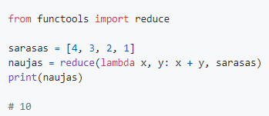
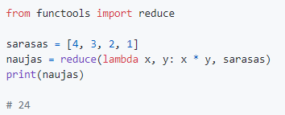
8 paskaita. Triukai su sąrašais
Funkcija reduce
5
Notes:
Also we're going to explore the reduce() function in Python. The reduce() function is a powerful tool for performing aggregations or reducing a sequence of elements to a single value. It allows us to apply a specific operation to the elements of a sequence iteratively. Let's dive into some examples to understand how the reduce() function can be applied.
In our first example, we have a list called sarasas with the values [4, 3, 2, 1]. Our goal is to calculate the sum of all the elements in the sarasas list using the reduce() function. Let's take a look at the code:
from functools import reduce sarasas = [4, 3, 2, 1] naujas = reduce(lambda x, y: x + y, sarasas) print(naujas) # Output: 10
In this code snippet, we import the reduce() function from the functools module. We then apply the reduce() function to the sarasas list.
Inside the reduce() function, we pass a lambda function as the first argument. The lambda function takes two arguments x and y and defines the operation to be performed on them. In this case, we add x and y together.
The reduce() function applies the lambda function iteratively to the elements of the sarasas list. It starts by taking the first two elements, 4 and 3, and performs the operation: 4 + 3 = 7. Then, it takes the result (7) and the next element (2) and performs the operation again: 7 + 2 = 9. Finally, it takes the result (9) and the last element (1) and performs the operation: 9 + 1 = 10.
The result, 10, is stored in the naujas variable, and when we print it, we get the output 10.
By utilizing the reduce() function with the lambda function, we successfully calculated the sum of all the elements in the sarasas list.
Now, let's move on to another example involving the reduce() function. Suppose we want to calculate the product of all the elements in the sarasas list. We can achieve this using the reduce() function in a similar manner. Take a
look at the code below:
from functools import reduce sarasas = [4, 3, 2, 1] naujas = reduce(lambda x, y: x * y, sarasas) print(naujas) # Output: 24
In this code snippet, we again import the reduce() function from the functools module. We apply the reduce() function to the sarasas list.
Inside the reduce() function, we pass a lambda function as the first argument. The lambda function takes two arguments x and y and defines the operation to be performed on them. In this case, we multiply x and y together.
The reduce() function applies the lambda function iteratively to the elements of the sarasas list. It starts by taking the first two elements, 4 and 3, and performs the operation: 4 * 3 = 12. Then, it takes the result (12) and the next element (2) and performs the operation again: 12 * 2 = 24. Finally, it takes the result (24) and the last element (1) and performs the operation: 24 * 1 = 24.
The result, 24, is stored in the naujas variable, and when we print it, we get the output 24.
By utilizing the reduce() function with the lambda function, we successfully calculated the product of all the elements in the sarasas list.
To summarize, the reduce() function is a powerful tool for performing aggregations or reducing a sequence of elements to a single value. It allows us to apply a specific operation to the elements of a sequence iteratively. The examples provided demonstrated how the reduce() function can be used to calculate the sum and product of elements in a list.
By importing the reduce() function from the functools module and utilizing lambda functions, we were able to perform these aggregations efficiently. It's worth noting that the reduce() function is not a built-in function in Python 3 and requires importing it from the functools module.
Exploring the capabilities of the reduce() function can enhance your ability to perform complex aggregations and computations on sequences of elements in Python.

Slide 8
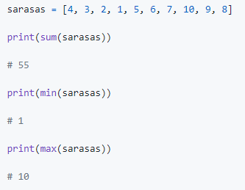
8 paskaita. Triukai su sąrašais
Funkcijos sum, max, min
6
Notes:
In Python, there are several built-in functions that are widely used for aggregating and analyzing data. These functions include sum(), min(), and max(). Let's explore each of these functions in detail.
The sum() function is used to calculate the sum of all the elements in a sequence. It takes a sequence as its input and returns the sum of all the elements. Let's look at an example:
sarasas = [4, 3, 2, 1, 5, 6, 7, 10, 9, 8] print(sum(sarasas)) # Output: 55
In this example, we have a list called sarasas with multiple numbers. By using the sum() function with the sarasas list as the input, we obtain the sum of all the numbers in the list. The output, in this case, is 55, which represents the sum of the elements in the sarasas list.
The min() function is used to find the minimum value among the elements in a sequence. It takes a sequence as its input and returns the smallest element. Let's see an example:
sarasas = [4, 3, 2, 1, 5, 6, 7, 10, 9, 8] print(min(sarasas)) # Output: 1
In this example, we have the same sarasas list. By using the min() function with the sarasas list as the input, we identify the smallest value in the list. The output, in this case, is 1, which represents the minimum element in the sarasas list.
Conversely, the max() function is used to find the maximum value among the elements in a sequence. It takes a sequence as its input and returns the largest element. Let's observe an example:
sarasas = [4, 3, 2, 1, 5, 6, 7, 10, 9, 8] print(max(sarasas)) # Output: 10
In this example, we again use the sarasas list. By utilizing the max() function with the sarasas list as the input, we identify the largest value in the list. The output, in this case, is 10, which represents the maximum element in the sarasas list.
To summarize, the sum(), min(), and max() functions are powerful tools for aggregating and analyzing data in Python. The sum() function calculates the sum of all the elements in a sequence, the min() function finds the minimum value, and the max() function finds the maximum value. These functions provide convenient ways to perform common operations on sequences of data.
In the examples provided, we used these functions to calculate the sum of all the numbers in a list, find the minimum value in a list, and identify the maximum value in a list. By incorporating these functions into your code, you can quickly obtain important insights about your data.

Slide 9
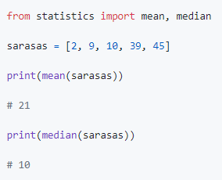
8 paskaita. Triukai su sąrašais
Vidurkis ir mediana
7
Notes:
And now we're going to explore two statistical functions in Python: mean() and median(). These functions, available in the statistics module, allow us to calculate the average and median of a sequence of numerical values. They are particularly useful when working with data analysis and statistics. Let's dive into each function in detail.
The mean() function calculates the average of a sequence of numerical values. It takes a sequence as its input and returns the arithmetic mean. Let's look at an example:
from statistics import mean sarasas = [2, 9, 10, 39, 45] print(mean(sarasas)) # Output: 21
In this example, we import the mean() function from the statistics module. We have a list called sarasas that contains several numerical values. By using the mean() function with the sarasas list as the input, we calculate the average of the values in the list. The output, in this case, is 21, which represents the mean of the elements in the sarasas list.
The mean() function works by summing up all the values in the sequence and dividing the sum by the number of elements. It provides us with a measure of central tendency, giving us an idea of the average value in the dataset.
Now, let's move on to the median() function. The median() function calculates the middle value in a sorted sequence of numerical values. It takes a sequence as its input and returns the median. Let's observe an example:
from statistics import median sarasas = [2, 9, 10, 39, 45] print(median(sarasas)) # Output: 10
In this example, we import the median() function from the statistics module. We use the same sarasas list as before. By utilizing the median() function with the sarasas list as the input, we calculate the median value. The output, in this case, is 10, which represents the median of the elements in the sarasas list.
The median() function works by first sorting the values in ascending order. If the number of elements is odd, the median is the middle value. If the number of elements is even, the median is the average of the two middle values. The median provides us with a measure of central tendency that is less affected by extreme values in the dataset.
To summarize, the mean() and median() functions from the statistics module are powerful tools for analyzing numerical data. The mean() function calculates the average value, while the median() function determines the middle value in a sorted sequence. These functions provide valuable insights into the central tendency of a dataset.
In the examples provided, we used the mean() function to calculate the average of a list of numbers and the median() function to find the middle value in a sorted list. By incorporating these functions into your code, you can gain a better understanding of the distribution and characteristics of your data.

Slide 10
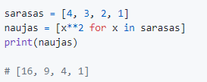
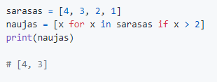
8 paskaita. Triukai su sąrašais
Sąrašo apimtis (List comprehension)
8
Notes:
Other important thing we're going to explore list comprehensions in Python. List comprehensions are a concise and powerful way to create new lists based on existing lists or other iterable objects. They allow us to perform operations on each element of a sequence and filter elements based on specific conditions. Let's dive into some examples to understand how list comprehensions work.
In our first example, we have a list called sarasas with the values [4, 3, 2, 1]. Our goal is to create a new list that contains the square of each element in the sarasas list. We can achieve this using a list comprehension. Let's take a look at the code:
sarasas = [4, 3, 2, 1] naujas = [x ** 2 for x in sarasas] print(naujas) # Output: [16, 9, 4, 1]
In this code snippet, we use a list comprehension to iterate over each element x in the sarasas list. For each element, we calculate its square using the expression x ** 2. The result is a new list called naujas, which contains the squared values of the elements in the sarasas list. When we print naujas, we get the following output:
[16, 9, 4, 1]
By utilizing list comprehensions, we successfully created a new list that contains the squares of the elements in the sarasas list.
Now, let's move on to another example involving filtering elements using list comprehensions. Suppose we want to filter out the elements from the sarasas list that are greater than 2. We can achieve this by adding a condition to the list comprehension. Take a look at the code below:
sarasas = [4, 3, 2, 1] naujas = [x for x in sarasas if x > 2] print(naujas) # Output: [4, 3]
In this code snippet, we use a list comprehension with an added condition. We iterate over each element x in the sarasas list, and the condition if x > 2 checks if the element is greater than 2. If the condition is true, the element is included in the new list naujas. When we print naujas, we get the following output:
[4, 3]
By incorporating the condition into the list comprehension, we successfully filtered out the elements from the sarasas list that are greater than 2.
To summarize, list comprehensions provide a concise and powerful way to create new lists in Python. They allow us to perform operations on each element of a sequence and filter elements based on specific conditions. In the examples provided, we used list comprehensions to calculate the squares of elements in a list and filter out elements based on a condition.
List comprehensions offer a compact and readable syntax, making code more expressive and efficient. They are a valuable tool in data manipulation, allowing us to transform and filter data in a concise and elegant manner.

Slide 11
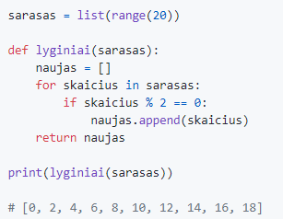
8 paskaita. Triukai su sąrašais
Lyginių skaičių paieška (įprastas būdas)
9
Notes:
Also we're going to explore the process of searching for even numbers in Python. We'll learn how to create a function that takes a list as input and returns a new list containing only the even numbers from the original list. Let's dive into an example to understand how this works.
In our example, we have a list called sarasas that contains numbers from 0 to 19. Our goal is to create a new list that only includes the even numbers from the sarasas list. Let's take a look at the code:
sarasas = list(range(20)) def lyginiai(sarasas): naujas = [] for skaicius in sarasas: if skaicius % 2 == 0: naujas.append(skaicius) return naujas print(lyginiai(sarasas)) # Output: [0, 2, 4, 6, 8, 10, 12, 14, 16, 18]
In this code snippet, we define a function called lyginiai that takes a list sarasas as its input. Inside the function, we create an empty list called naujas that will store our even numbers.
We then use a for loop to iterate over each element skaicius in the sarasas list. Inside the loop, we use the modulo operator % to check if the number is divisible by 2, indicating that it is an even number. If the condition skaicius % 2 == 0 is true, we append the number to the naujas list using the append() method.
Finally, we return the naujas list, which contains all the even numbers from the original sarasas list. When we print the result of calling the lyginiai function with the sarasas list as input, we get the following output:
[0, 2, 4, 6, 8, 10, 12, 14, 16, 18]
By implementing this function, we successfully filtered out the even numbers from the sarasas list and created a new list containing only those numbers.
To summarize, searching for even numbers in Python involves creating a function that iterates over a given list, checks if each number is divisible by 2, and adds the even numbers to a new list. The example provided demonstrates this process, where we defined a function lyginiai to find the even numbers from a given list sarasas.
Implementing this logic allows us to selectively extract specific elements from a list based on a condition, enabling us to perform various data filtering tasks.

Slide 12

8 paskaita. Triukai su sąrašais
Lyginių skaičių paieška (su list comprehension)
10
Notes:
And now we're going to explore a more concise approach to searching for even numbers in Python using list comprehensions. List comprehensions offer a compact and elegant way to filter elements from a list based on specific conditions. Let's dive into an example to understand how this works.
In our example, we have a list called sarasas that contains numbers from 0 to 19. Our goal is to create a new list that only includes the even numbers from the sarasas list. We can achieve this using a list comprehension. Let's take a look at the code:
sarasas = list(range(20)) lyginiai = [x for x in sarasas if x % 2 == 0] print(lyginiai) # Output: [0, 2, 4, 6, 8, 10, 12, 14, 16, 18]
In this code snippet, we use a list comprehension to iterate over each element x in the sarasas list. For each element, we include it in the new list lyginiai if the condition x % 2 == 0 is true, indicating that the number is even.
Let's break down the list comprehension syntax:
The expression [x for x in sarasas] defines the elements to include in the new list. In this case, we simply include each element x from the sarasas list.
The if x % 2 == 0 part adds a condition to the list comprehension. It filters out the elements that do not satisfy the condition, ensuring that only even numbers are included in the new list.
When we run this code and print the lyginiai list, we get the following output:
[0, 2, 4, 6, 8, 10, 12, 14, 16, 18]
By utilizing a list comprehension, we successfully filtered out the even numbers from the sarasas list and created a new list containing only those numbers.
To summarize, searching for even numbers in Python can be done in a concise and efficient manner using list comprehensions. By combining the iteration and filtering steps into a single expression, we can create a new list that includes only the even numbers from the original list. The example provided demonstrates this approach, where we used a list comprehension to find the even numbers from a given list sarasas.
List comprehensions offer a more compact and readable syntax, making the code more expressive and efficient. They are a valuable tool in data manipulation, allowing us to filter data and create new lists in a concise and elegant manner.

Slide 13
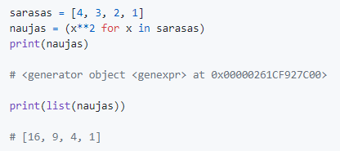
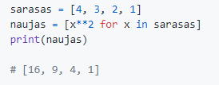
8 paskaita. Triukai su sąrašais
Atkreipkime dėmesį į rezultato kintamojo tipą!
11
Notes:
Understanding the type of a variable is essential in Python as it allows us to know the nature and behavior of the data stored in that variable. Python is a dynamically-typed language, meaning that variables can hold different types of data throughout the program. Let's explore the concept of variable types in Python.
In the first example, we have a list called sarasas with the values [4, 3, 2, 1]. We then create a new variable naujas using a generator expression inside parentheses. A generator expression is similar to a list comprehension but produces a generator object instead of a list. Let's take a look at the code:
sarasas = [4, 3, 2, 1] naujas = (x**2 for x in sarasas) print(naujas) # Output: <generator object <genexpr> at 0x00000261CF927C00> print(list(naujas)) # Output: [16, 9, 4, 1]
In this code snippet, we assign a generator expression (x**2 for x in sarasas) to the variable naujas. When we print the naujas variable, we see the output <generator object <genexpr> at 0x00000261CF927C00>. This tells us that naujas is a generator object, a special type of iterable in Python.
Generators are lazy iterators that produce values on-the-fly as they are requested, which makes them memory-efficient. In this case, the generator expression calculates the square of each element x in the sarasas list. However, the actual computation does not happen until we iterate over the generator using the list() function. When we print list(naujas), we get the output [16, 9, 4, 1], which represents the squared values of the elements in the sarasas list.
Moving on to the second example, we have the same list sarasas but create a new variable naujas using a list comprehension. Let's see the code:
sarasas = [4, 3, 2, 1] naujas = [x**2 for x in sarasas] print(naujas) # Output: [16, 9, 4, 1]
In this code snippet, we use a list comprehension to create a new list naujas that contains the squared values of the elements in the sarasas list. The output when we print naujas is [16, 9, 4, 1], which represents the squared values.
Unlike the generator expression, a list comprehension immediately calculates all the squared values and stores them in a list. This list can be accessed and printed directly.
To summarize, the type of a variable in Python determines the behavior and operations that can be performed on that variable. In the examples provided, we encountered two different types of variables: a generator object and a list. The generator object was created using a generator expression and produced values on-the-fly, while the list was created using a list comprehension and immediately stored all the values in memory.
Understanding the type of a variable helps us work with the data more effectively and choose appropriate operations or methods to manipulate it. It is important to be aware of the type of the variable in order to use the appropriate syntax and functions for that specific type.

Slide 14
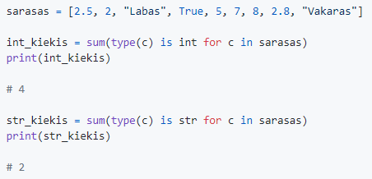
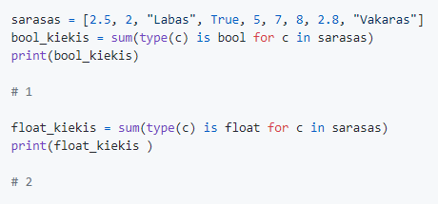
8 paskaita. Triukai su sąrašais
Sąrašo elementų tipų skaičiavimas
12
Notes:
Calculating list elements in Python allows us to perform operations based on the type of each element. By understanding the type of each element, we can count the occurrences of specific types within a list. Let's explore an example to understand how this works.
In our example, we have a list called sarasas with various elements, including integers, strings, booleans, and floats. Our goal is to count the number of elements of each type in the sarasas list. Let's take a look at the code:
sarasas = [2.5, 2, "Labas", True, 5, 7, 8, 2.8, "Vakaras"] int_kiekis = sum(type(c) is int for c in sarasas) print(int_kiekis) # Output: 4 str_kiekis = sum(type(c) is str for c in sarasas) print(str_kiekis) # Output: 2 bool_kiekis = sum(type(c) is bool for c in sarasas) print(bool_kiekis) # Output: 1 float_kiekis = sum(type(c) is float for c in sarasas) print(float_kiekis) # Output: 2
In this code snippet, we use list comprehensions along with the type() function and the sum() function to count the number of occurrences for each type.
For counting the number of integers, we use the expression type(c) is int inside a list comprehension. This expression evaluates to True if the element c is of type int, and False otherwise. The sum() function then sums up all the True values, effectively counting the number of integers in the sarasas list.
Similarly, we use list comprehensions and the type() function to count the number of strings, booleans, and floats in the sarasas list.
When we run this code, we get the following outputs:
int_kiekis: 4 (indicating the number of integers)
str_kiekis: 2 (indicating the number of strings)
bool_kiekis: 1 (indicating the number of booleans)
float_kiekis: 2 (indicating the number of floats)
By utilizing the type() function, list comprehensions, and the sum() function, we successfully calculated the number of elements of each type in the sarasas list.
To summarize, calculating list elements in Python allows us to count the occurrences of specific types within a list. By using the type() function, list comprehensions, and the sum() function, we can determine the number of elements of each type. This technique is valuable when working with diverse datasets and analyzing the composition of lists.

Slide 15
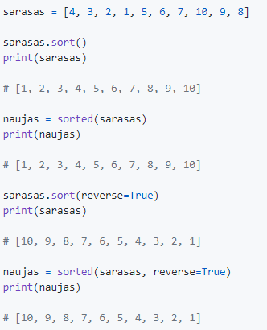
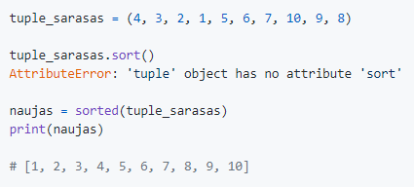
8 paskaita. Triukai su sąrašais
Duomenų rūšiavimas
sort() - nepakeičia esamo sąrašo
sorted() - gražina pakeistą sąrašą
13
Notes:
When working with data in Python, we often need to sort it in a specific order to make it more organized and easier to analyze. Python provides two functions, sort() and sorted(), for sorting data. Let's explore these functions in detail.
In our first example, we have a list called sarasas with the values [4, 3, 2, 1, 5, 6, 7, 10, 9, 8]. Our goal is to sort the elements of the list in ascending order. We can achieve this using the sort() function. Let's take a look at the code:
sarasas = [4, 3, 2, 1, 5, 6, 7, 10, 9, 8] sarasas.sort() print(sarasas) # Output: [1, 2, 3, 4, 5, 6, 7, 8, 9, 10]
In this code snippet, we call the sort() function on the sarasas list. The sort() function sorts the list in-place, meaning it modifies the original list directly. When we print sarasas, we get the following output:
[1, 2, 3, 4, 5, 6, 7, 8, 9, 10]
The elements of the list are now arranged in ascending order.
Next, let's explore the sorted() function. The sorted() function also sorts the elements of a sequence, but it returns a new sorted list while leaving the original list unchanged. Let's see an example:
sarasas = [4, 3, 2, 1, 5, 6, 7, 10, 9, 8] naujas = sorted(sarasas) print(naujas) # Output: [1, 2, 3, 4, 5, 6, 7, 8, 9, 10]
In this code snippet, we use the sorted() function with the sarasas list as input. The sorted() function creates a new list, naujas, that contains the sorted elements of the sarasas list. When we print naujas, we get the same output as before:
[1, 2, 3, 4, 5, 6, 7, 8, 9, 10]
The sorted() function allows us to obtain a sorted version of the original list without modifying it.
Lastly, let's discuss the behavior of sort() and sorted() with other data types. In the example with tuple_sarasas, which is a tuple instead of a list, we attempt to use the sort() function. However, we encounter an AttributeError because tuples are immutable, and the sort() function modifies the original object in-place. Tuples do not have a sort() method.
To sort a tuple, we can use the sorted() function. It returns a new sorted list, as demonstrated in the following code:
tuple_sarasas = (4, 3, 2, 1, 5, 6, 7, 10, 9, 8) naujas = sorted(tuple_sarasas) print(naujas) # Output: [1, 2, 3, 4, 5, 6, 7, 8, 9, 10]
By using the sorted() function on the tuple_sarasas, we obtain the sorted elements in a new list called naujas.
In summary, when working with data in Python, we can utilize the sort() function to sort a list in-place, modifying the original list directly. Alternatively, the sorted() function allows us to obtain a new sorted list without modifying the original. It is important to note that the sort() function cannot be used with immutable data types like tuples. Instead, we can use the sorted() function to sort them and obtain a new list.

Slide 16
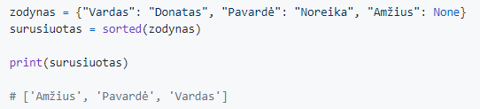
8 paskaita. Triukai su sąrašais
Žodynų rūšiavimas
14
Notes:
Sorting dictionaries in Python involves arranging the keys of a dictionary in a specific order. Since dictionaries in Python are unordered, sorting them requires extracting the keys, sorting them, and then accessing the corresponding values. Let's delve into an example to understand how to sort dictionaries.
In our example, we have a dictionary called zodynas with key-value pairs representing personal information. Our goal is to sort the keys of the dictionary in alphabetical order. Let's take a look at the code:
zodynas = {"Vardas": "Donatas", "Pavardė": "Noreika", "Amžius": None} surusiuotas = sorted(zodynas) print(surusiuotas) # Output: ['Amžius', 'Pavarde', 'Vardas‘]
In this code snippet, we use the sorted() function with the zodynas dictionary as input. The sorted() function extracts the keys of the dictionary, sorts them in alphabetical order, and returns a new list called surusiuotas.
When we print surusiuotas, we get the following output:
['Amžius', 'Pavarde', 'Vardas‘]
The keys of the dictionary are now sorted in alphabetical order.
It's important to note that dictionaries are inherently unordered data structures, meaning they do not preserve the order of elements. However, by sorting the keys and accessing the values based on the sorted keys, we can achieve a sorted representation of the dictionary.
To summarize, sorting dictionaries in Python involves extracting the keys, sorting them, and accessing the corresponding values based on the sorted keys. The sorted() function enables us to sort the keys of a dictionary and obtain a new list of sorted keys. However, since dictionaries are inherently unordered, the sorted keys provide a sorted representation of the dictionary. In the provided example, we sorted the keys of the zodynas dictionary alphabetically and obtained the output ['Amžius', 'Pavarde', 'Vardas'].

Slide 17
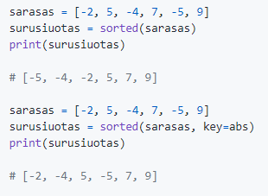
8 paskaita. Triukai su sąrašais
Rušiavimas pagal absoliutinę reikšmę
15
Notes:
Sorting according to the absolute value in Python allows us to sort a list based on the magnitude of the elements, disregarding their sign. This is useful when we want to sort elements based on their numerical value without considering whether they are positive or negative. Let's explore an example to understand how this works.
In our example, we have a list called sarasas with various positive and negative numbers. Our goal is to sort the list based on the absolute value of the elements. We can achieve this using the sorted() function and providing a custom key argument. Let's take a look at the code:
sarasas = [-2, 5, -4, 7, -5, 9] surusiuotas = sorted(sarasas) print(surusiuotas) # Output: [-5, -4, -2, 5, 7, 9]
In this code snippet, we use the sorted() function without any additional arguments. By default, the sorted() function sorts the elements of the list in ascending order. When we print surusiuotas, we get the following output:
[-5, -4, -2, 5, 7, 9]
The list is sorted in ascending order, taking into account the signs of the numbers. Negative numbers appear first, followed by positive numbers.
Now, let's explore how to sort based on the absolute value of the elements. We can achieve this by providing a key argument to the sorted() function, specifying that the sorting should be based on the absolute value of each element. Let's see the code:
sarasas = [-2, 5, 4, 7, -5, 9] surusiuotas = sorted(sarasas, key=abs) print(surusiuotas) # Output: [-2, -4, 5, -5, 7, 9]
In this code snippet, we use the key=abs argument in the sorted() function. This indicates that the sorting should be based on the absolute value of each element. When we print surusiuotas, we get the following output:
[-2, -4, 5, -5, 7, 9]
The list is now sorted based on the absolute value of the elements, regardless of their sign. The absolute values are used as the sorting criteria, resulting in a list where the elements with smaller absolute values appear first, followed by those with larger absolute values.
To summarize, sorting according to the absolute value in Python allows us to sort a list based on the magnitude of the elements, disregarding their sign. By providing a key argument to the sorted() function and using the abs function as the key function, we can sort the list based on the absolute value of each element. This technique is useful when we want to sort elements based on their numerical value without considering their signs. In the given examples, we sorted the sarasas list using the sorted() function, obtaining the outputs [-5, -4, -2, 5, 7, 9] and [-2, -4, 5, -5, 7, 9] respectively.

Slide 18
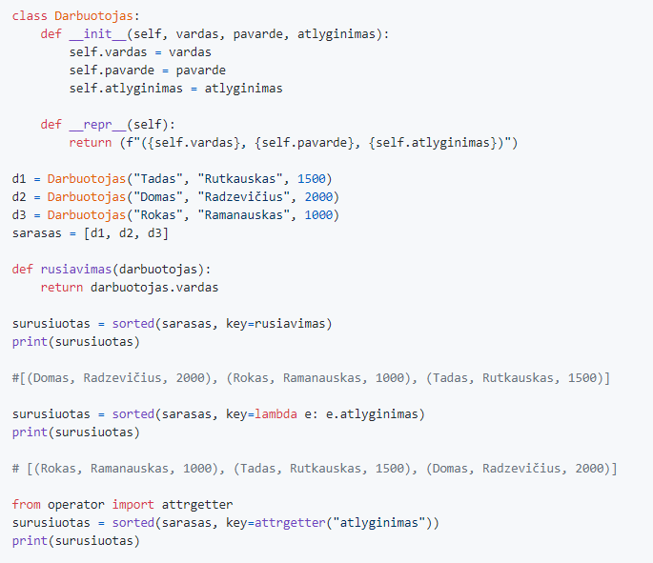
8 paskaita. Triukai su sąrašais
Objektų rūšiavimas sąraše
16
Notes:
Sorting objects in a list in Python allows us to order the objects based on specific attributes or properties of those objects. This is useful when we have a collection of objects and want to arrange them in a particular order. Let's explore an example to understand how to sort objects in a list.
In our example, we have a class called Darbuotojas, representing employees with attributes such as name, surname, and salary. We want to sort a list of Darbuotojas objects based on their attributes. Let's take a look at the code:
class Darbuotojas: def __init__(self, vardas, pavarde, atlyginimas): self.vardas = vardas self.pavarde = pavarde self.atlyginimas = atlyginimas def __repr__(self): return f"({self.vardas}, {self.pavarde}, {self.atlyginimas})" d1 =
Darbuotojas("Tadas", "Rutkauskas", 1588) d2 = Darbuotojas("Donas", "Radzevičius", 2088) d3 = Darbuotojas("Rokas", "Ramanauskas", 1988) sarasas = [d1, d2, d3] def rusiavimas(darbuotojas): return darbuotojas.vardas surusiuotas = sorted(sarasas, key=rusiavimas) print(surusiuotas) # Output: [(Donas, Radzevičius, 2088), (Rokas, Ramanauskas, 1988), (Tadas, Rutkauskas, 1588)]
In this code snippet, we define a class called Darbuotojas with an __init__() method to initialize the attributes and a __repr__() method to provide a string representation of the object. We create three Darbuotojas objects (d1, d2, d3) and store them in a list called sarasas.
To sort the list of Darbuotojas objects based on the vardas (name) attribute, we define a rusiavimas() function that returns the vardas attribute of a given Darbuotojas object. We then use the sorted() function with the key argument set to rusiavimas to perform the sorting. The resulting list, surusiuotas, is printed, and we obtain the following output:
[(Donas, Radzevičius, 2088), (Rokas, Ramanauskas, 1988), (Tadas, Rutkauskas, 1588)]
The objects in the list are now sorted based on the vardas attribute in alphabetical order.
We can also use lambda functions or the attrgetter function from the operator module to simplify the sorting process. Here's an example using a lambda function:
surusiuotas = sorted(sarasas, key=lambda e: e.atlyginimas) print(surusiuotas) # Output: [(Tadas, Rutkauskas, 1588), (Rokas, Ramanauskas, 1988), (Donas, Radzevičius, 2088)]
In this code, we sort the list of Darbuotojas objects based on the atlyginimas (salary) attribute using a lambda function as the key. The resulting list is printed, and we obtain the following output:
[(Tadas, Rutkauskas, 1588), (Rokas, Ramanauskas, 1988), (Donas, Radzevičius, 2088)]
Finally, we can achieve the same result using the attrgetter function:
from operator import attrgetter surusiuotas = sorted(sarasas, key=attrgetter("atlyginimas")) print(surusiuotas) # Output: [(Tadas, Rutkauskas, 1588), (Rokas, Ramanauskas, 1988), (Donas, Radzevičius, 2088)]
In this code, we import the attrgetter function from the operator module and use it as the key argument in the sorted() function to sort the list of Darbuotojas objects based on the atlyginimas attribute.
To summarize, sorting objects in a list in Python allows us to arrange the objects based on specific attributes or properties. By using the sorted() function with a custom key argument, we can define the criteria for sorting the objects. The examples provided demonstrate sorting Darbuotojas objects based on the vardas and atlyginimas attributes. Additionally, we explored lambda functions and the attrgetter function as alternatives for defining the sorting criteria.

Slide 19
8 paskaita. Triukai su sąrašais
Užduotis nr. 1
Sukurti programą, kuri:
Prie kiekvieno sakinio su jūsų pasirinktu tekstu, pridėtų šauktuką ir atspausdintų naują sakinį.
Patarimai:
Naudoti map (su lambda) arba comprehension, " ".join()
16

Slide 20
8 paskaita. Triukai su sąrašais
Užduotis nr. 2
Sukurti programą, kuri:
Sukurtų sąrašą iš skaičių nuo 0 iki 50
Padaugintų visus sąrašo skaičius iš 10 ir atspausdintų
Atrinktų iš sąrašo skaičius, kurie dalinasi iš 7 ir atspausdintų
Pakeltų visus sąrašo skaičius kvadratu ir atspausdintų
Su kvadratų sąrašu atliktų šiuos veiksmus: atspausdintų sumą, mažiausią ir didžiausią skaičių, vidurkį, medianą
Surūšiuotų ir atspausdintų kvadratų sąrašą atbulai
Patarimai:
Naudoti map, filter arba comprehension, sum, min, max, mean, median, %
from statistics import mean, median
17

Slide 21
8 paskaita. Triukai su sąrašais
Užduotis nr. 3
Duotas sąrašas: sarasas = [2.5, 2, "Labas", True, 5, 7, 8, 2.8, "Vakaras"]
Sukurti programą, kuri:
Paskaičiuotų ir atspausdintų visų sąrašo skaičių sumą
Sudėtų ir atspausdintų visus sąrašo žodžius
Suskaičiuotų ir atspausdintų, kiek sąraše yra loginių (boolean) kintamųjų su True reikšme
Patarimai:
Naudoti filter arba comprehension, sum, " ".join()
18

Slide 22
8 paskaita. Triukai su sąrašais
Užduotis nr. 4
Sukurti programą, kuri:
Turėtų klasę Zmogus, su savybėmis vardas ir amzius
Klasėje būtų repr metodas, kuris atvaizduotų vardą ir amžių
Inicijuoti kelis Zmogus objektus su vardais ir amžiais
Įdėti sukurtus Zmogus objektus į naują sąrašą
Surūšiuotų ir atspausdintų sąrašo objektus pagal vardą ir pagal amžių (ir atbulai)
Patarimai:
Naudoti sorted, attrgetter, reverse, funkciją repr
from operator import attrgetter
19

Slide 23
8 paskaita. Triukai su sąrašais
Namų darbas
Užbaigti klasėje nepadarytas užduotis
20

Slide 24
8 paskaita. Triukai su sąrašais
Išspręsti paskaitos uždaviniai (įkelti ketvirtadienį)
https://github.com/aurimas13/Python-Beginner-Course/tree/main/Programs
DB browser for SQLite
https://sqlitebrowser.org/
Duomenų bazės SQLite programa
Naudinga informacija

